Slide 1


Slide 2
ANL488 BA Applied Project
Supervisor Meeting #2
Ho Kai Toong
Use of ANN to predict Oil & Gas Recovery Factor
Progress:
 | 10% |  | 20% |  | 30% |  | 40% |  | 50% |  | 60% |  | 70% |  | 80% |  | 90% |  | 100%

Slide 3
Progress Report
Progress since last meeting
Attempted Boostrapping on TORIS
Conducted Different Hyperparameters Tuning Approach (Random Search, Grid Search, and Manual Tuning)
Performed K-Fold Cross Validation on TORIS and GOM
Currently at deployment stage but still trying to achieve better results for the ANN model in Python

Slide 4
ANN Model Constructed Using Python
TORIS (Bootstrapping)
Approach | Results
Number of Iterations | 50 | 100
Mean MAE | 0.1264 | 0.1269
Mean R-Square Value | 0.0806 | 0.0799
High MAE and very low R-Square value
Bootstrapping is not suitable for TORIS dataset

Slide 5
ANN Model Constructed Using Python
TORIS (Increase Number of Hidden Layers & Neurons)
 | 1 Hidden Layer | 2 Hidden Layers | 2 Hidden Layers
Number of Neurons in Hidden Layer | 3 | 5, 3 | 7, 5
MAE | 0.0892 | 0.1129 | 0.1116
R-Square Value | 0.3372 | 0.0238 | 0.0804
Increasing number of hidden layers and neurons did not improve model’s performance

Slide 6
ANN Model Constructed Using Python
TORIS (Optimized Hyperparameters)
Hyperparameters | Optimized Solution
Hyperparameter Search Approach (Random Search, Grid Search, and Manual Tuning) | Manual Tuning
Input Variables Used | All
Number of Hidden Layers and Neurons | 1 (3 Neurons)
Epoch | 9
Batch Size | 5
Optimizer | Adam
Activation Functions | Relu (Hidden Layer) and Linear (Output Layer)
MAE | 0.0892
R-Square Value | 0.3372

Slide 7
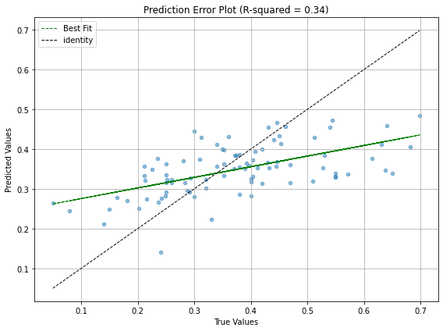
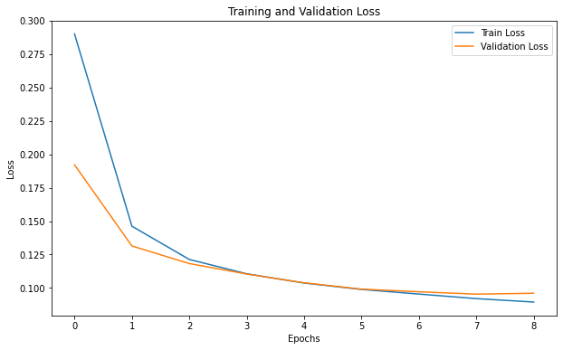
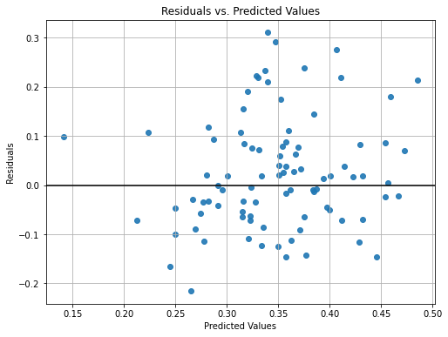
ANN Model Constructed Using Python
TORIS

Slide 8
ANN Model Constructed Using Python
TORIS (K-Fold Cross Validation)
K-Fold | 5 | 10 | 15 | 149 | 447 (LOOCV)
Mean Training Loss | 0.0698 | 0.0612 | 0.0586 | 0.0459 | 0.0389
Mean Validation Loss | 0.0815 | 0.0730 | 0.0685 | 0.0515 | 0.0425
Variation between Mean Training loss & Mean Validation Loss | 0.0116 | 0.0118 | 0.0099 | 0.0056 | 0.0036
Std Dev Validation Loss | 0.0141 | 0.0184 | 0.0188 | 0.0386 | 0.0638
R-Square Value | 0.3599 | 0.4577 | 0.4996 | 0.7571 | 0.6870
Increasing K-Fold boosted the model’s performance but also the variability of the model’s predictions

Slide 9
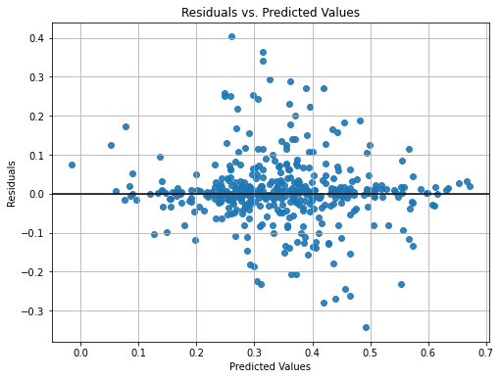
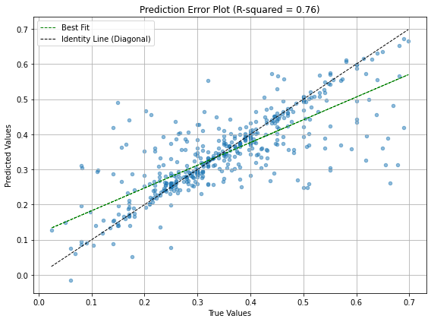
ANN Model Constructed Using Python
TORIS

Slide 10
IBM SPSS Modeler vs Python
TORIS
 | IBM SPSS Modeler | Python
 | - | ANN Model | ANN Model with K-Fold Cross-Validation
Number of Hidden Layers Used | 1 | 1 | 1
Number of Neurons in Hidden Layer Used | 2 | 3 | 3
MAE | 0.111 | 0.089 | 0.052
R-Square Value | 0.16 | 0.34 | 0.76

Slide 11
ANN Model Constructed Using Python
GOM (Z-Score Threshold)
Approach | Results
Z-Score Threshold | Nil | 4
MAE | 0.1016 | 0.0976
R-Square Value | 0.3781 | 0.4334
Setting a Z-Score threshold helps to reduce outliers and improve model’s performance

Slide 12
ANN Model Constructed Using Python
GOM (Optimized Hyperparameters)
Hyperparameters | Optimized Solution
Hyperparameter Search Approach (Random Search, Grid Search, and Manual Tuning) | Manual Tuning
Input Variables Used | All
Number of Hidden Layers and Neurons | 2 (10 & 5 Neurons)
Epoch | 50
Batch Size | 8
Optimizer | Adam
Activation Functions | Relu (Hidden Layer) and Tanh (Output Layer)
MAE | 0.0976
R-Square Value | 0.4334

Slide 13
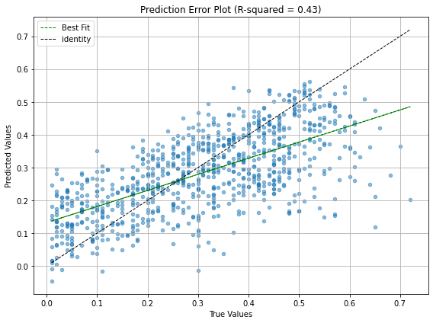
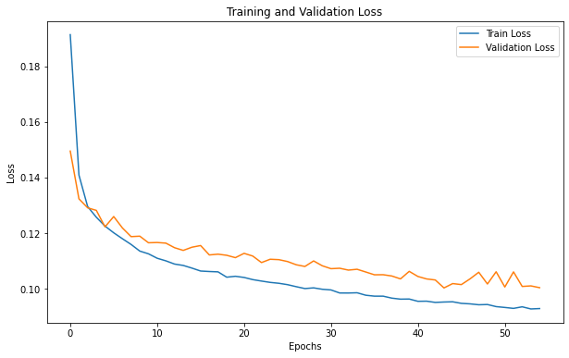
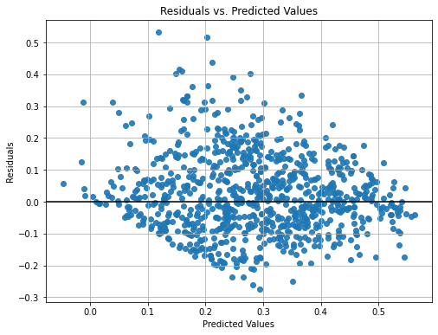
ANN Model Constructed Using Python
GOM

Slide 14
ANN Model Constructed Using Python
GOM (K-Fold Cross Validation)
K-Fold | 5 | 10 | 15 | 20
Mean Training Loss | 0.0868 | 0.0839 | 0.0832 | 0.0819
Mean Validation Loss | 0.0939 | 0.0900 | 0.0893 | 0.0875
Variation between Mean Training loss & Mean Validation Loss | 0.0070 | 0.0062 | 0.0060 | 0.0056
Std Dev Validation Loss | 0.0031 | 0.0048 | 0.0045 | 0.0067
R-Square Value | 0.4364 | 0.4763 | 0.4900 | 0.5033
Increasing K-Fold boosted the model’s performance but also the variability of the model’s predictions

Slide 15
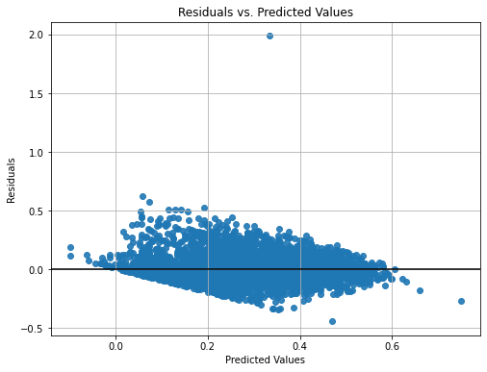
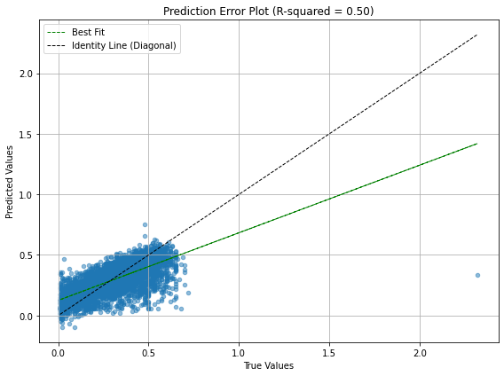
ANN Model Constructed Using Python
GOM

Slide 16
IBM SPSS Modeler vs Python
GOM
 | IBM SPSS Modeler | Python
 | - | ANN Model | ANN Model with K-Fold Cross-Validation
Number of Hidden Layers Used | 1 | 2 | 2
Number of Neurons in Hidden Layer Used | 9 | 10, 5 | 10, 5
MAE | 0.117 | 0.098 | 0.088
R-Square Value | 0.25 | 0.43 | 0.50

Slide 17
IBM SPSS Modeler vs Python (Overall)
TORIS & GOM
Testing Set | TORIS |  | GOM
 | MAE | R-Square | MAE | R-Square
IBM SPSS Modeler | 0.111 | 0.16 | 0.117 | 0.25
Python (ANN Model) | 0.089 | 0.34 | 0.098 | 0.43
Python (ANN Model with K-Fold Cross Validation) | 0.052 | 0.76 | 0.088 | 0.50
ANN Models in Python outperforms ANN models in IBM SPSS Modeler
Tuning of hyperparameters allows better optimization of ANN model results
ANN Models with K-Fold Cross Validation in Python contain the best performance

Slide 18
Updates
Goals until next meeting (30 Oct 2023)
Optimize ANN results in python

Slide 19
Learning
Bootstrapping
Hyperparameters Tuning Approach (Random Search, Grid Search, and Manual Tuning)
Z-Score Threshold to reduce outliers
K-Fold Cross-Validation for better estimation of model’s performance

Slide 20
Challenges
How to further optimize ANN model results?

Slide 21
Concerns

